Slide 1
Relational Database Design

Slide 2
Introduction
Relational database design (RDD) models’ information and data into a set of tables with rows and columns.
Each row of a relation/table represents a record, and each column represents an attribute of data.
The Structured Query Language (SQL) is used to manipulate relational databases.
The design of a relational database is composed of four stages, where the data are modeled into a set of related tables.
The stages are −
Define relations/attributes
Define primary keys
Define relationships
Normalization

Slide 3
Relational databases differ from other databases in their approach to organizing data and performing transactions.
In an RDD, the data are organized into tables and all types of data access are carried out via controlled transactions.
Relational database design satisfies the ACID (atomicity, consistency, integrity, and durability) properties required from a database design.
Relational database design mandates the use of a database server in applications for dealing with data management problems.

Slide 4
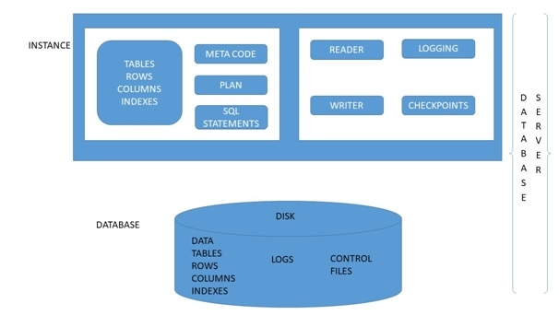

Slide 5
Relational Database Design Process
Database design is more art than science, as you have to make many decisions.
Databases are usually customized to suit a particular application.
No two customized applications are alike, and hence, no two databases are alike.
Guidelines (usually in terms of what not to do instead of what to do) are provided in making these design decision, but the choices ultimately rest on the designer.
Step 1 − Define the Purpose of the Database (Requirement Analysis)
Gather the requirements and define the objective of your database.
Drafting out the sample input forms, queries and reports often help.

Slide 6
Step 2 − Gather Data, Organize in tables and Specify the Primary Keys
Once you have decided on the purpose of the database, gather the data that are needed to be stored in the database.
Divide the data into subject-based tables.
Choose one column (or a few columns) as the so-called primary key, which uniquely identifies the each of the rows.

Slide 7
Step 3 − Create Relationships among Tables
A database consisting of independent and unrelated tables serves little purpose (you may consider using a spreadsheet instead).
The power of a relational database lies in the relationship that can be defined between tables.
The most crucial aspect in designing a relational database is to identify the relationships among tables. The types of relationship include:
one-to-many
many-to-many
one-to-one

Slide 8
One-to-Many
In a "class roster" database, a teacher may teach zero or more classes, while a class is taught by one (and only one) teacher.
In a "company" database, a manager manages zero or more employees, while an employee is managed by one (and only one) manager.
In a "product sales" database, a customer may place many orders; while an order is placed by one particular customer.
This kind of relationship is known as one-to-many.

Slide 9
To support a one-to-many relationship, we need to design two tables: for e.g. a table Classes to store information about the classes with classID as the primary key; and a table Teachers to store information about teachers with teacherID as the primary key.
We can then create the one-to-many relationship by storing the primary key of the table Teacher (i.e., teacherID) (the "one"-end or the parent table) in the table classes (the "many"-end or the child table), as illustrated below.

Slide 10
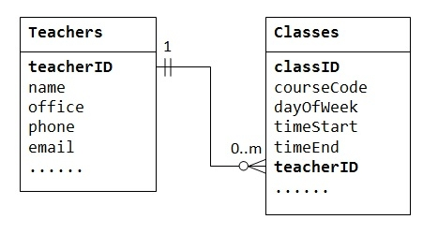
The column teacherID in the child table Classes is known as the foreign key.
A foreign key of a child table is a primary key of a parent table, used to reference the parent table.

Slide 11
Many-to-Many
In a "product sales" database, a customer's order may contain one or more products; and a product can appear in many orders.
In a "bookstore" database, a book is written by one or more authors; while an author may write zero or more books.
This kind of relationship is known as many-to-many.

Slide 12
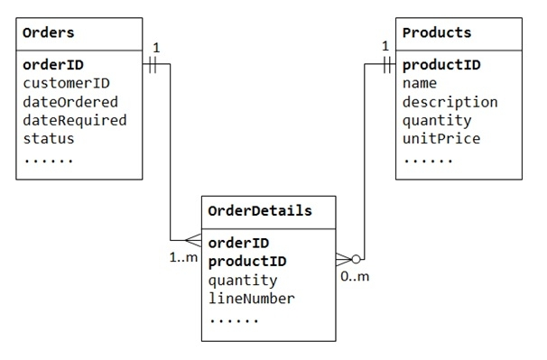

Slide 13
The many-to-many relationship is, in fact, implemented as two one-to-many relationships, with the introduction of the junction table.
An order has many items in OrderDetails. An OrderDetails item belongs to one particular order.
A product may appear in many OrderDetails. Each OrderDetails item specified one product.

Slide 14
One-to-One
In a "product sales" database, a product may have optional supplementary information such as image, more description and comment.
Keeping them inside the Products table results in many empty spaces (in those records without these optional data).
Furthermore, these large data may degrade the performance of the database.

Slide 15
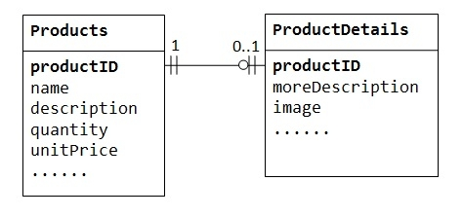

Slide 16
Column Data Types
You need to choose an appropriate data type for each column.
Commonly data types include integers, floating-point numbers, string (or text), date/time, binary, collection (such as enumeration and set).
Step 4 − Refine & Normalize the Design
For example,
adding more columns,
create a new table for optional data using one-to-one relationship,
split a large table into two smaller tables,
Other methods.

